Slide 1
UNIT 3: Transaction Processing & Concurrency Control

Slide 2
Non-Serializable Schedules
A non-serial schedule which is not serializable is called as a non-serializable schedule.
A non-serializable schedule is not guaranteed to produce the the same effect as produced by some serial schedule on any consistent database.
Characteristics-
Non-serializable schedules-
may or may not be consistent
may or may not be recoverable
Irrecoverable Schedules-
If in a schedule,
A transaction performs a dirty read operation from an uncommitted transaction
And commits before the transaction from which it has read the value then such a schedule is known as an Irrecoverable Schedule.

Slide 3
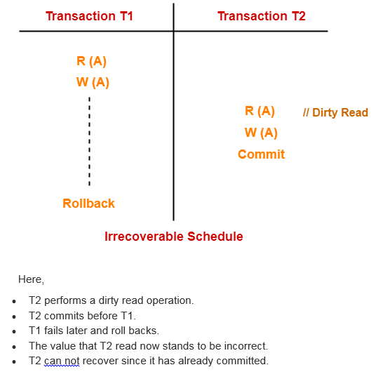

Slide 4
Recoverable Schedules-
If in a schedule,
A transaction performs a dirty read operation from an uncommitted transaction
And its commit operation is delayed till the uncommitted transaction either commits or roll backs then such a schedule is known as a Recoverable Schedule.
Here,
The commit operation of the transaction that performs the dirty read is delayed.
This ensures that it still has a chance to recover if the uncommitted transaction fails later.

Slide 5
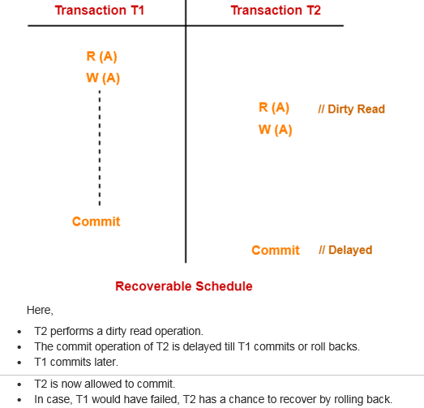

Slide 6
Checking Whether a Schedule is Recoverable or Irrecoverable-
METHOD 1
Check whether the given schedule is conflict serializable or not.
If the given schedule is conflict serializable, then it is surely recoverable. Stop and report your answer.
If the given schedule is not conflict serializable, then it may or may not be recoverable. Go and check using other methods.
Thumb Rules All conflict serializable schedules are recoverable. All recoverable schedules may or may not be conflict serializable.

Slide 7
Method-02:
Check if there exists any dirty read operation.
(Reading from an uncommitted transaction is called as a dirty read)
If there does not exist any dirty read operation, then the schedule is surely recoverable. Stop and report your answer.
If there exists any dirty read operation, then the schedule may or may not be recoverable.
If there exists a dirty read operation, then follow the following cases-
Case-01:
If the commit operation of the transaction performing the dirty read occurs before the commit or abort operation of the transaction which updated the value, then the schedule is irrecoverable.
Case-02:
If the commit operation of the transaction performing the dirty read is delayed till the commit or abort operation of the transaction which updated the value, then the schedule is recoverable.

Slide 8
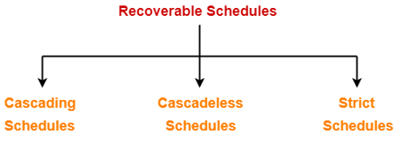
Recoverable Schedules-
If in a schedule,
A transaction performs a dirty read operation from an uncommitted transaction
And its commit operation is delayed till the uncommitted transaction either commits or roll backs then such a schedule is called as a Recoverable Schedule.
Types of Recoverable Schedules-
A recoverable schedule may be any one of these kinds-

Slide 9
Cascading Schedule-
If in a schedule, failure of one transaction causes several other dependent transactions to rollback or abort, then such a schedule is called as a Cascading Schedule or Cascading Rollback or Cascading Abort.
It simply leads to the wastage of CPU time.

Slide 10
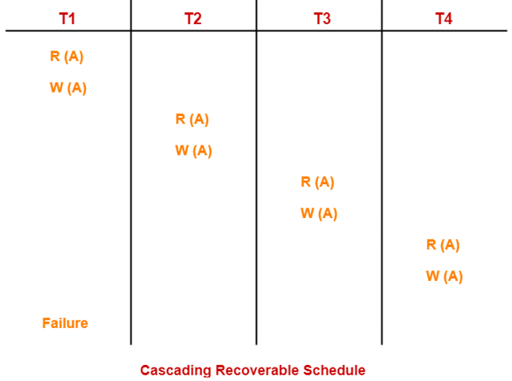
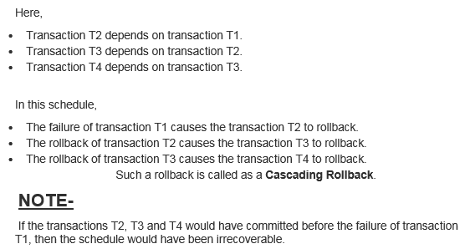

Slide 11
Cascadeless Schedule-
If in a schedule, a transaction is not allowed to read a data item until the last transaction that has written it is committed or aborted, then such a schedule is called as a Cascadeless Schedule.
In other words,
Cascadeless schedule allows only committed read operations.
Therefore, it avoids cascading roll back and thus saves CPU time.

Slide 12
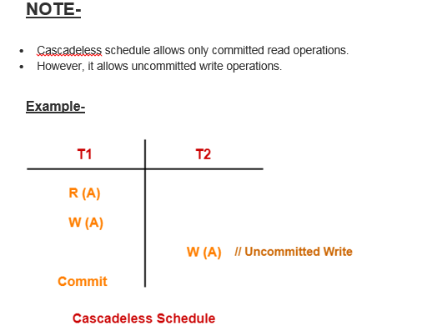
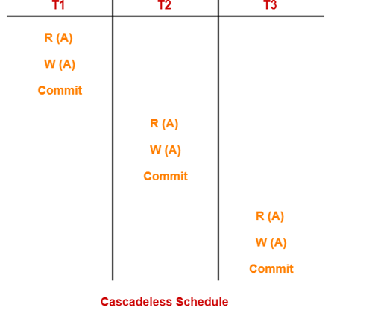

Slide 13
Strict Schedule-
If in a schedule, a transaction is neither allowed to read nor write a data item until the last transaction that has written it is committed or aborted, then such a schedule is called as a Strict Schedule.
In other words,
Strict schedule allows only committed read and write operations.
Clearly, strict schedule implements more restrictions than cascadeless schedule.

Slide 14
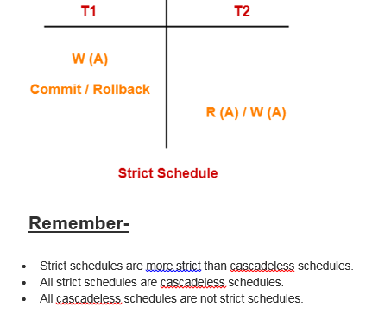
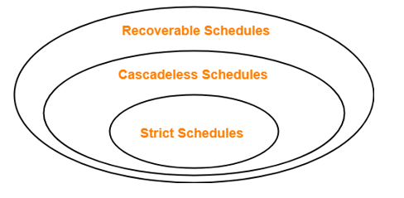

Slide 15
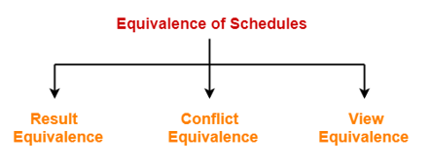
Equivalence of Schedules-
In DBMS, schedules may have the following three different kinds of equivalence relations among them-

Slide 16
1. Result Equivalent Schedules-
If any two schedules generate the same result after their execution, then they are called as result equivalent schedules.
This equivalence relation is considered of least significance.
This is because some schedules might produce same results for some set of values and different results for some other set of values.
2. Conflict Equivalent Schedules-
If any two schedules satisfy the following two conditions, then they are called as conflict equivalent schedules-
The set of transactions present in both the schedules is same.
The order of pairs of conflicting operations of both the schedules is same.
3. View Equivalent Schedules-
We have already discussed about View Equivalent Schedules

Slide 17
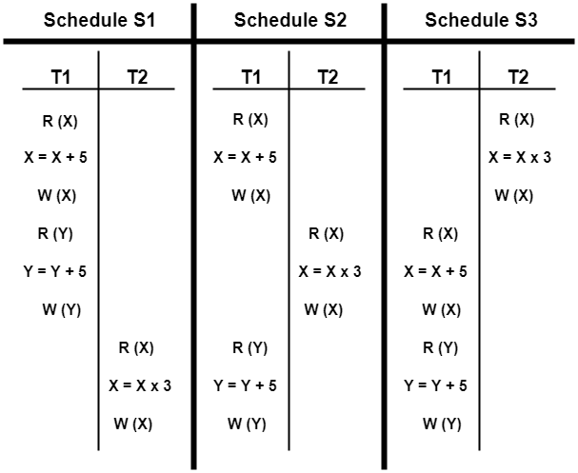
Are the following three schedules result equivalent?

Slide 18
To check whether the given schedules are result equivalent or not,
We will consider some arbitrary values of X and Y.
Then, we will compare the results produced by each schedule.
Those schedules which produce the same results will be result equivalent.
Let X = 2 and Y = 5.
On substituting these values, the results produced by each schedule are-
Results by Schedule S1- X = 21 and Y = 10
Results by Schedule S2- X = 21 and Y = 10
Results by Schedule S3- X = 11 and Y = 10
Clearly, the results produced by schedules S1 and S2 are same.
Thus, we conclude that S1 and S2 are result equivalent schedules.

Slide 19
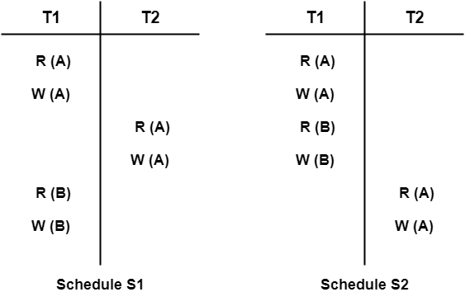
Are the following two schedules conflict equivalent?

Slide 20
To check whether the given schedules are conflict equivalent or not,
We will write their order of pairs of conflicting operations.
Then, we will compare the order of both the schedules.
If both the schedules are found to have the same order, then they will be conflict equivalent.
For schedule S1-
The required order is-
R₁(A) , W₂(A)
W₁(A) , R₂(A)
W₁(A) , W₂(A)
For schedule S2-
The required order is-
R₁(A) , W₂(A)
W₁(A) , R₂(A)
W₁(A) , W₂(A)
Clearly, both the given schedules have the same order.
Thus, we conclude that S1 and S2 are conflict equivalent schedules.

Slide 21
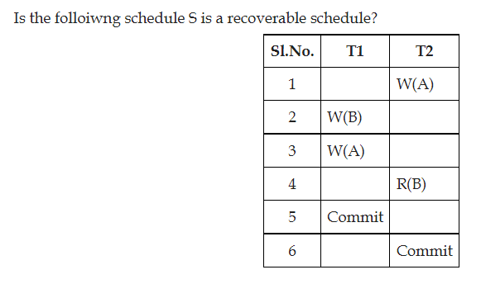

Slide 22
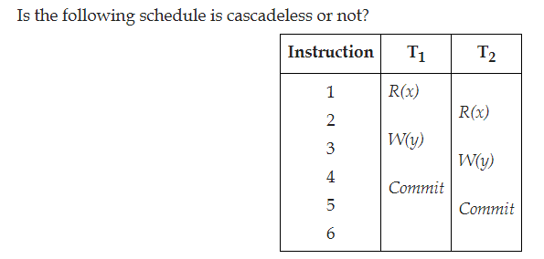
This schedule is cascadeless because there is no dirty read.

Slide 23
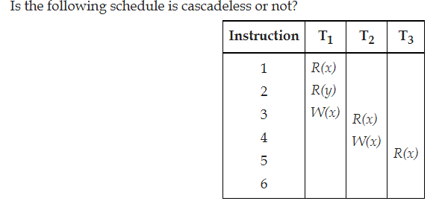
This schedule is said to be a partial schedule as it does not consist of either commit or abort statements. In this schedule, if T₁ fails and aborted then T₂ which is dependent on T₁ has to be rolled back and T₃ which is dependent on T₂ has also to be rolled back. This type of rollback is called as cascading rollback. Hence, this schedule is not a cascadeless schedule.

Slide 24
Which concurrency control protocols ensure conflict serializability and freedom from the deadlock? A) 2-phase locking B) Time-stamp Ordering C) Both 2-phase locking and Time-stamp ordering D) None of the above ANSWER:- B Explanation :2PL, i.e., 2 Phase Locking, is a concurrency control method that guarantees serializability. This protocol uses locks applied to data by a transaction, which blocks other transactions from accessing the same data during the transaction's life. Mutual blocking of 2 or more transactions may lead to deadlock in 2PL.

Slide 25
Which among the following statements is/are incorrect? 1) A schedule following a strict two-phase locking protocol is conflict serializable and recoverable. 2) Checkpoint in schedules inserted to ensure recoverability. A) Only 1 B) Only 2 C) Both 1 and 2 D) None of the above ANSWER:- B Explanation :A basic two-phase locking protocol ensures only conflict serializability. In contrast, a strict two-phase locking protocol ensures conflict serializability and recoverability. So statement (1) is correct. i.e., checkpoints are inserted to minimize the task of undo-redo in recoverability. And hence statement (2) is not correct. So Option (B) is correct.

